Slide 1


Talent Management 2016 +
Selection, Recruitment, Retention

Slide 2
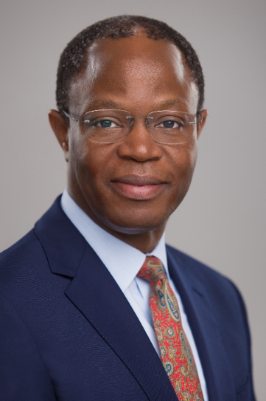


What makes us different
Alexander Partners bridge the gap between graduates, recent graduates and your ever changing selection, recruitment and retention demands. Because we know you are continually looking for talented individuals who fit, we focus on identifying, developing and supporting candidates that are more than simply academically qualified.
The corner stone of our philosophy is our ability to evaluate and match the Competencies, Skills, and Motivational factors (CSM) of applicants and new hirers with your demands. We proactively work with talent to increase their true added value and overall Career Capital.
Dr Ambroz Neil

Slide 3

Highest performing organisations adopt strategies that rely heavily on having talented employees
Organisational strategies range from:
Creating the Right Organisational Culture
Developing New Products & Services
Driving Innovation
Gaining Market Share
Improving Customer Experience.

Slide 4

Graduate talent is routinely sourced and recruited using third parties
WORKPLACE SUPPORT
(Formative Period)
Employers,
Alexander Partners
SELECTION
(Final Selection)
Employers
SELECTION
(Short Listing)
Employers, Alexander Partners
SELECTION
(Initial Screening)
Employers,
Recruitment Agencies, Testing Platforms (eg SHL), Alexander Partners
SOURCING GRADUATE TALENT
Employers, Recruitment Agencies, Career Services, Platforms (Target, LinkedIn), Alexander Partners

Slide 5

Potential employers must understand todays pool of graduate talent
Comfortable working in teams
Great at multi-tasking
Highly educated
Longing to prove themselves on the job
Motivated by making a difference
Natural collaborators
Tech and social media savvy

Slide 6

There are a number of key indicators that Millennials look for in employers
Source: Collegefeed, 2014

Slide 7

Our unique approach positively impact on the four constraints on recruitment (CARP)
Corporate Image
Attractiveness of Job
Recruitment Costs
Policies.

Slide 8

Our unique approach also positively impacts on the four pillars used to evaluate recruitment (RYCE)
Retention Rate (percentage of talent remaining at the organisation during their formative period)
Yield Ratio (comparison, number of applicants at each stage of the recruitment process)
Calibre (overall quality of applicants)
Evaluation (Ratio of recruitment costs to benefits).

Slide 9
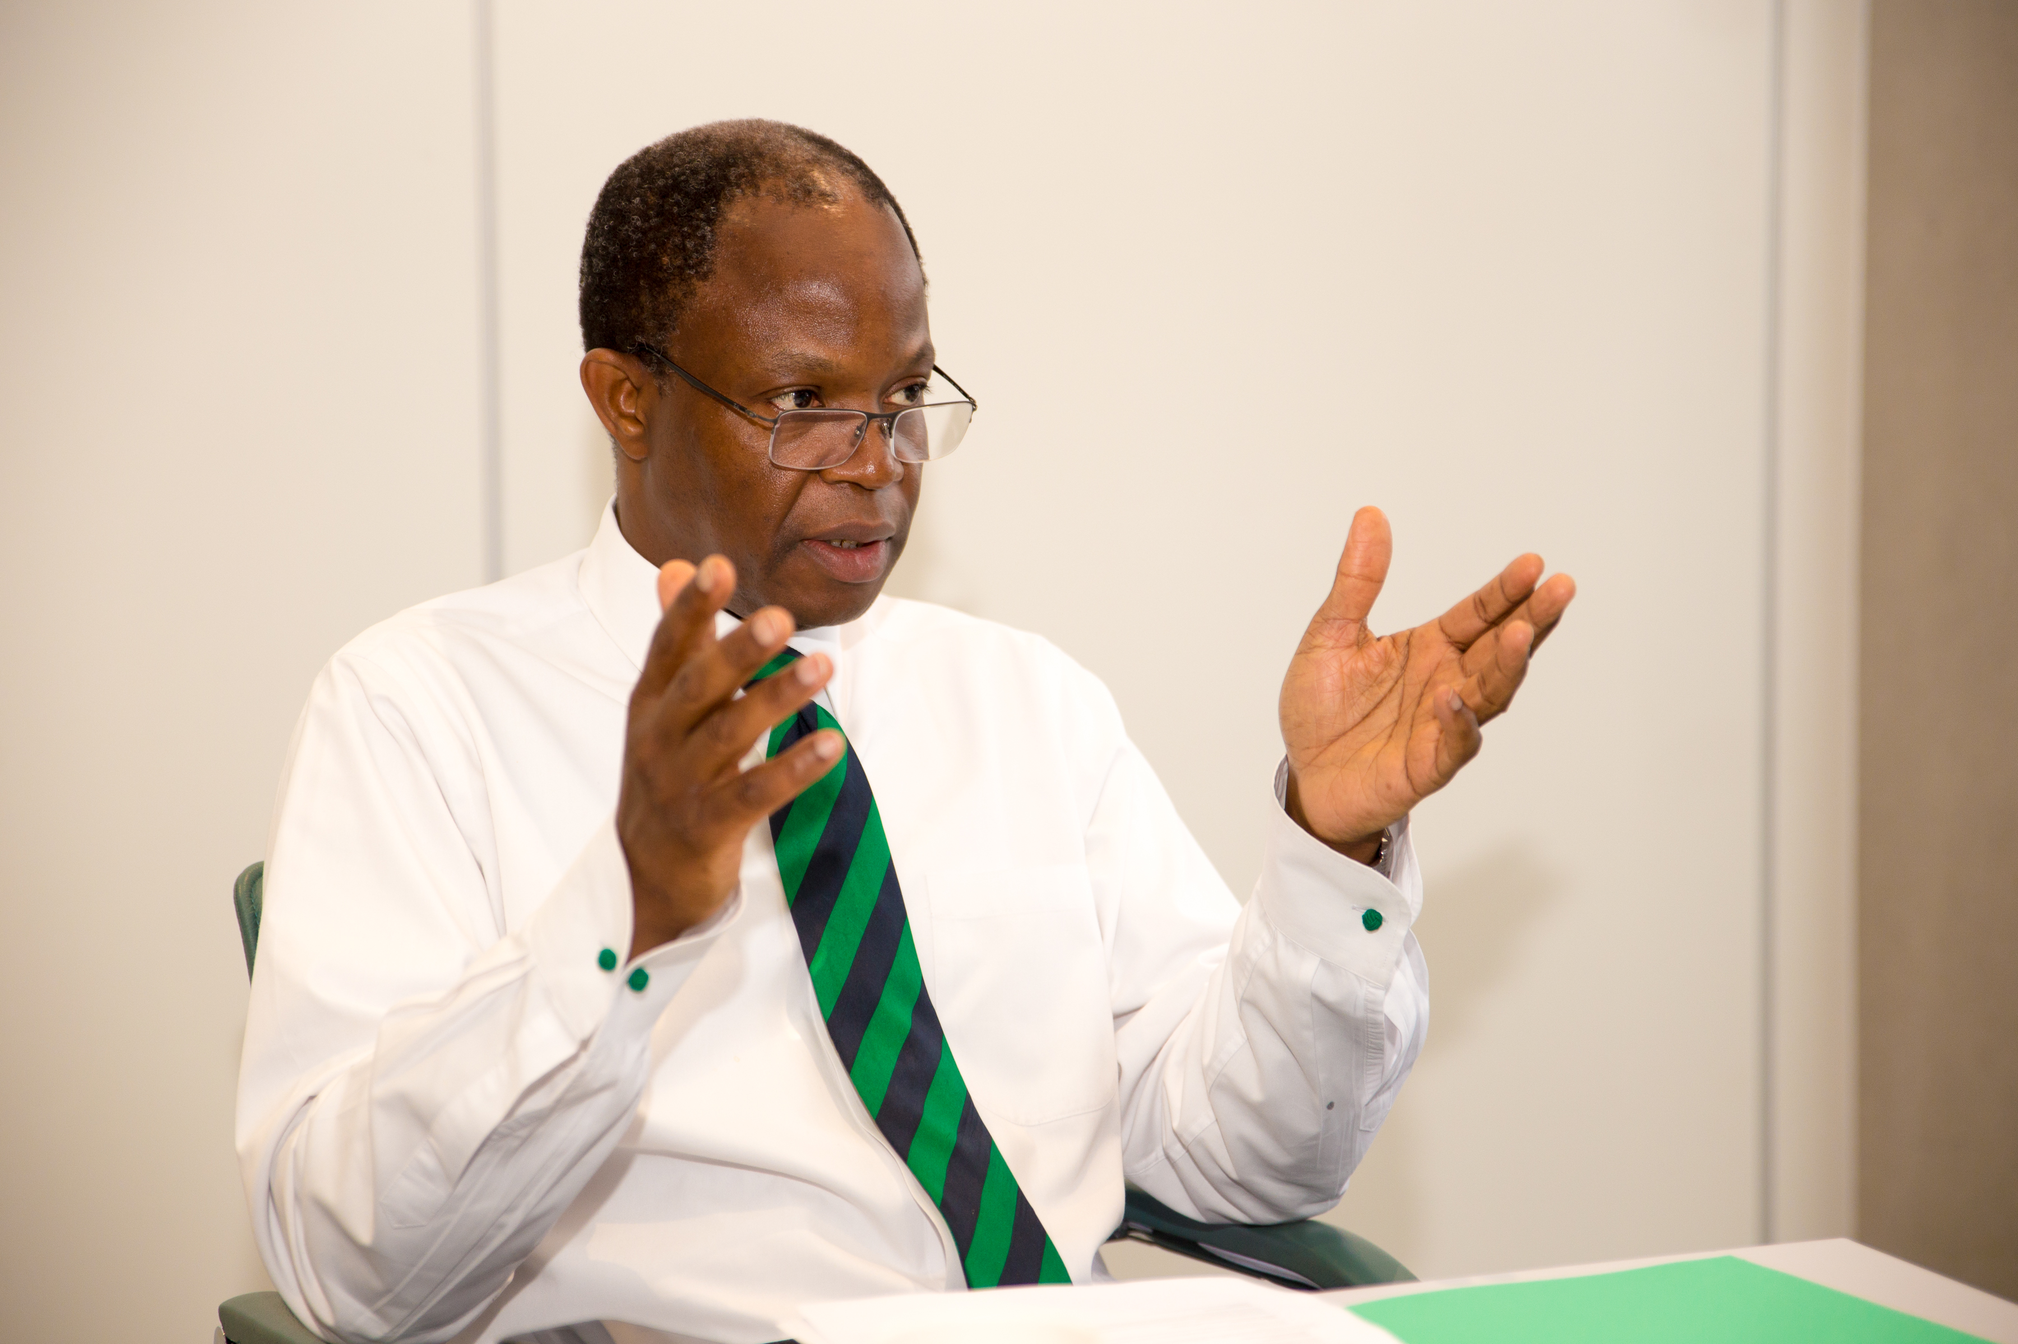
How we deliver our philosophy
3
2
During their formative years, we provide your pool of graduate talent with 1-to-1 mentoring – your organisation benefits when your senior executives and pool of graduate talent are independently mentored.
1
Based on this TGTP, we identify and work with graduates to strengthen their profile before introducing them to you (Targeted Profile Screening).
Define your Target Graduate Talent Profile (TGTP) by extensively mapping your existing talent pool using our unique CSM approach.

Slide 10
Our approach supports key indicators of what Millennials look for in employers
Talent will be attracted to our innovative approach.
Organisation and talent will expect more from the relationship.
Talent are accustomed to working and playing hard.
An engaged talent pool delivers more.
Less frustration during the transition from university to corporate life.

Slide 11
How our approach to selection, recruitment and retention benefits your organisation
Corporate Attractiveness Recruitment Policies
Image of Job Cost Strength
Retention Yield Ratio Calibre of Evaluation
Graduate (Cost/Benefit)
Constraints on Recruitment
Recruitment Evaluation

Slide 12

Alexander Partners is not a recruitment agency. We are far more
We specialise in graduate talent identification, development and retention;
Work directly with employers to maximise the impact of their search for talent by working with talent to make them more employable;
Introduce talent that better match organisational requirements and;
Mentor newly recruited talent during their formative period with the organisation.

Slide 13



Address:
Alexander Partners, 7th Floor, Westgate House, Westgate Road, London W5 1YY
Tel:
+44(0) 2037 553 712
Website:
www.alexanderpartners.org.uk
Email:
info@alexanderpartners.org.uk

